Slide 1
Java Programming, 9e Chapter 7
Characters, Strings, and the StringBuilder

Slide 2
Objectives
Identify string data problems
Use Character class methods
Declare and compare String objects
Use other String methods
Use the StringBuilder and StringBuffer classes

Slide 3
Understanding String Data Problems (1 of 4)
Manipulating characters and groups of characters provides some challenges for the beginning Java programmer
A String is a class
Each created String is a class object
The String variable name is not a simple data type
Reference
A variable that holds a memory address

Slide 4
Understanding String Data Problems (2 of 4)
Compare two Strings using the == operator
Not comparing values
Comparing computer memory locations
Compare contents of memory locations more frequently than memory locations themselves

Slide 5
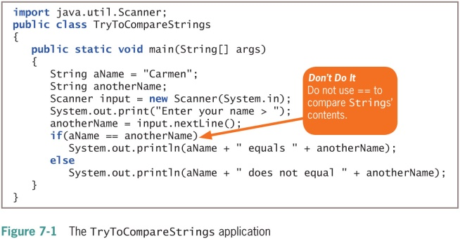
Understanding String Data Problems (3 of 4)

Slide 6
Understanding String Data Problems (4 of 4)
Classes to use when working with character data
Character
Instances hold a single character value
Defines methods that can manipulate or inspect single-character data
String
A class for working with fixed-string data
Unchanging data composed of multiple characters
StringBuilder and StringBuffer
Classes for storing and manipulating changeable data composed of multiple characters

Slide 7
Using Character Class Methods (1 of 4)
Character class
Contains standard methods for testing the values of characters
Methods that begin with “is”
Such as isUpperCase()
Return a Boolean value that can be used in comparison statements
Methods that begin with “to”
Such as toUpperCase()
Return a character that has been converted to the stated format

Slide 8
Using Character Class Methods (2 of 4)
Table 7-1 Commonly used methods of the Character class
Method | Description
isUpperCase () | Tests if character is uppercase
toUpperCase () | Returns the uppercase equivalent of the argument; no change is made if the argument is not a lowercase letter
islowerCase () | Tests if character is lowercase
tolowerCase () | Returns the lowercase equivalent of the argument; no change is made if the argument is not an uppercase letter
isDigit() | Returns true if the argument is a digit (0–9) and false otherwise
isletter() | Returns true if the argument is a letter and false otherwise
isletterOrDigit() | Returns true if the argument is a letter or digit and false otherwise
isWhitespace () | Returns true if the argument is whitespace and false otherwise; this includes the space, tab, newline, carriage return, and form feed

Slide 9
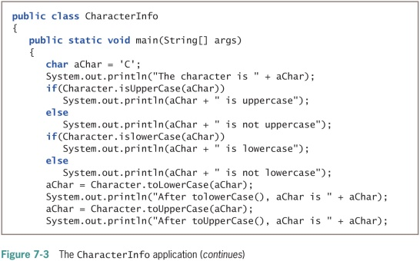
Using Character Class Methods (3 of 4)

Slide 10
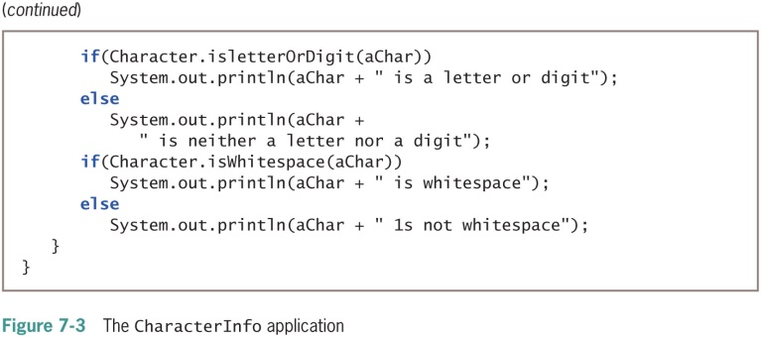
Using Character Class Methods (4 of 4)

Slide 11
Declaring and Comparing String Objects (1 of 2)
Literal string
A sequence of characters enclosed within double quotation marks
An unnamed object, or anonymous object, of the String class
String variable
A named object of the String class
Class String
Defined in java.lang.String
Automatically imported into every program

Slide 12
Declaring and Comparing String Objects (2 of 2)
Declare a String variable
The String itself is distinct from the variable used to refer to it
Create a String object
String aGreeting = new String("Hello");
String aGreeting = "Hello";
You can create a String object without:
Using the keyword new
Explicitly calling the class constructor

Slide 13
Comparing String Values (1 of 6)
String is a class
Each created String is a class object
String variable name
A reference variable
Refers to a location in memory
Rather than to a particular value
Assign a new value to a String
The address held by the String is altered

Slide 14
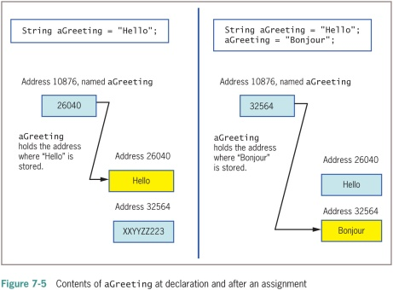
Comparing String Values (2 of 6)

Slide 15
Comparing String Values (3 of 6)
Immutable
Objects that cannot be changed, such as a String
Making simple comparisons between Strings often produces misleading results
Comparing Strings using the == operator
Compares memory addresses, not values

Slide 16
Comparing String Values (4 of 6)
equals() method
Evaluates the contents of two String objects to determine if they are equivalent
Returns true if objects have identical contents
public boolean equals(String s)
equalsIgnoreCase() method
Ignores case when determining if two Strings are equivalent
Useful when users type responses to prompts in programs

Slide 17
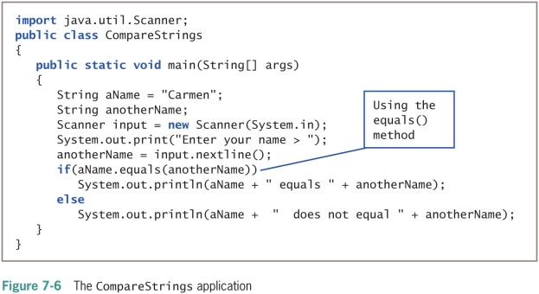
Comparing String Values (5 of 6)

Slide 18
Comparing String Values (6 of 6)
compareTo() method
Compares two Strings and returns:
Zero: If two Strings refer to the same value
Negative number: If the calling object is “less than” the argument
Positive number: If the calling object is “more than” the argument
if (aWord.compareTo(anotherWord) < 0)

Slide 19
Empty and null Strings
Empty Strings
Reference a memory address with no characters
Can be used in String methods
null Strings
Use the null Java keyword
Strings are set to null by default
Cannot be used in String methods

Slide 20
Using a Variety of String Methods (1 of 6)
toUpperCase() and toLowerCase() methods
Convert any String to its uppercase or lowercase equivalent
length() method
Returns the length of a String
indexOf() method
Determines whether a specific character occurs within a String
Returns the position of the character
The first position of a String is zero
The return value is –1 if the character does not exist in the String

Slide 21
Using a Variety of String Methods (2 of 6)
charAt() method
Requires an integer argument
Indicates the position of the character that the method returns
endsWith() method and startsWith() method
Each takes a String argument
Return true or false if a String object does or does not end or start with the specified argument, respectively

Slide 22
Using a Variety of String Methods (3 of 6)
replace() method
Replaces all occurrences of some character within a String
toString() method
Not part of the String class
Converts any object to a String
Converts primitive data types to Strings
String theString;
int someInt = 4;
theString = Integer.toString(someInt);

Slide 23
Using a Variety of String Methods (4 of 6)
Concatenation
Join a simple variable to a String
String aString = "My age is " + myAge;
Use the + operator
substring() method
Extracts part of a String
Takes two integer arguments
Start position
End position
The length of the extracted substring is the difference between the second integer and the first integer

Slide 24
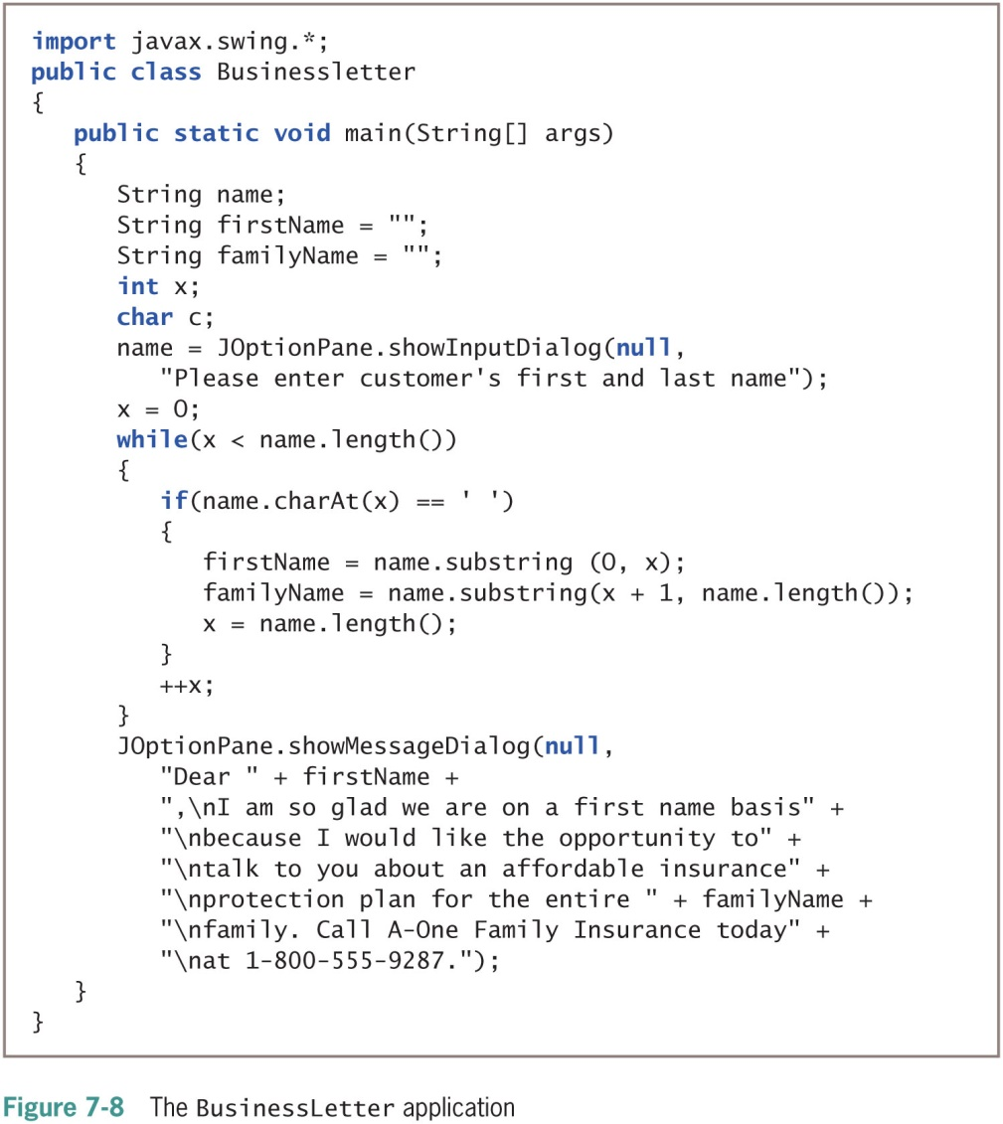
Using a Variety of String Methods (5 of 6)

Slide 25
Using a Variety of String Methods (6 of 6)
regionMatches() method
Two variants that can be used to test if two String regions are equal
A substring of the specified String object is compared to a substring of the other
If the substrings contain the same character sequence, then the expression is true
Otherwise, the expression is false
A second version uses an additional boolean argument
Determines whether case is ignored when comparing characters

Slide 26
Converting String Objects to Numbers (1 of 2)
Integer class
Part of java.lang
Automatically imported into programs
Converts a String to an integer
parseInt() method
Takes a String argument
Returns its integer value
Wrapper
A class or an object “wrapped around” a simpler element

Slide 27
Converting String Objects to Numbers (2 of 2)
Integer class valueOf() method
Converts a String to an Integer class object
Integer class intValue() method
Extracts the simple integer from its wrapper class
Double class
A wrapper class
Imported into programs automatically
parseDouble() method
Takes a String argument and returns its double value

Slide 28
Learning About the StringBuilder and StringBuffer Classes (1 of 10)
The value of a String is fixed
After a String is created, it is immutable
StringBuilder and StringBuffer classes
An alternative to the String class
Used when a String will be modified
Can use anywhere you would use a String
Part of the java.lang package
Automatically imported into every program

Slide 29
Learning About the StringBuilder and StringBuffer Classes (2 of 10)
StringBuilder
More efficient
StringBuffer
Thread safe
Use in multithreaded programs

Slide 30
Learning About the StringBuilder and StringBuffer Classes (3 of 10)
Create a StringBuilder object
StringBuilder eventString = new StringBuilder ("Hello there");
Must use:
The keyword new
The constructor name
An initializing value between the constructor’s parentheses

Slide 31
Learning About the StringBuilder and StringBuffer Classes (4 of 10)
Buffer
A memory block
Might or might not contain a String
The String might not occupy the entire buffer
The length of a String can be different from the length of the buffer
Capacity
The actual length of the buffer

Slide 32
Learning About the StringBuilder and StringBuffer Classes (5 of 10)
setLength() method
Changes the length of a String in a StringBuilder object
length property
An attribute of the StringBuilder class
Identifies the number of characters in the String contained in the StringBuilder
capacity() method
Finds the capacity of a StringBuilder object

Slide 33
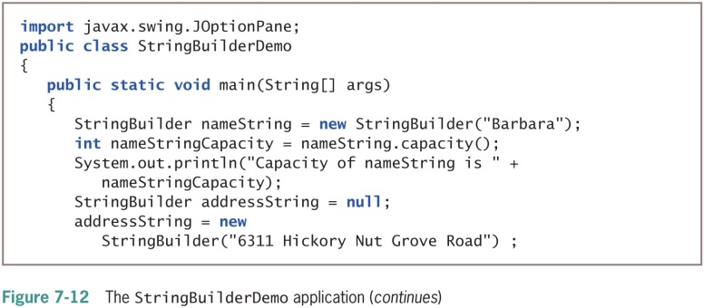
Learning About the StringBuilder and StringBuffer Classes (6 of 10)

Slide 34
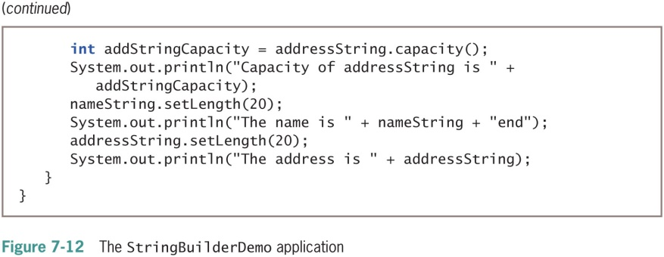
Learning About the StringBuilder and StringBuffer Classes (7 of 10)

Slide 35
Learning About the StringBuilder and StringBuffer Classes (8 of 10)
Using StringBuilder objects
Provides improved computer performance over String objects
Can insert or append new contents into StringBuilder
StringBuilder constructors
public StringBuilder ()
public StringBuilder (int capacity)
public StringBuilder (String s)

Slide 36
Learning About the StringBuilder and StringBuffer Classes (9 of 10)
append() method
Adds characters to the end of a StringBuilder object
insert() method
Adds characters at a specific location within a StringBuilder object
setCharAt() method
Changes a character at a specified position within a StringBuilder object
charAt() method
Accepts an argument that is the offset of the character position from the beginning of a String
Returns the character at that position

Slide 37
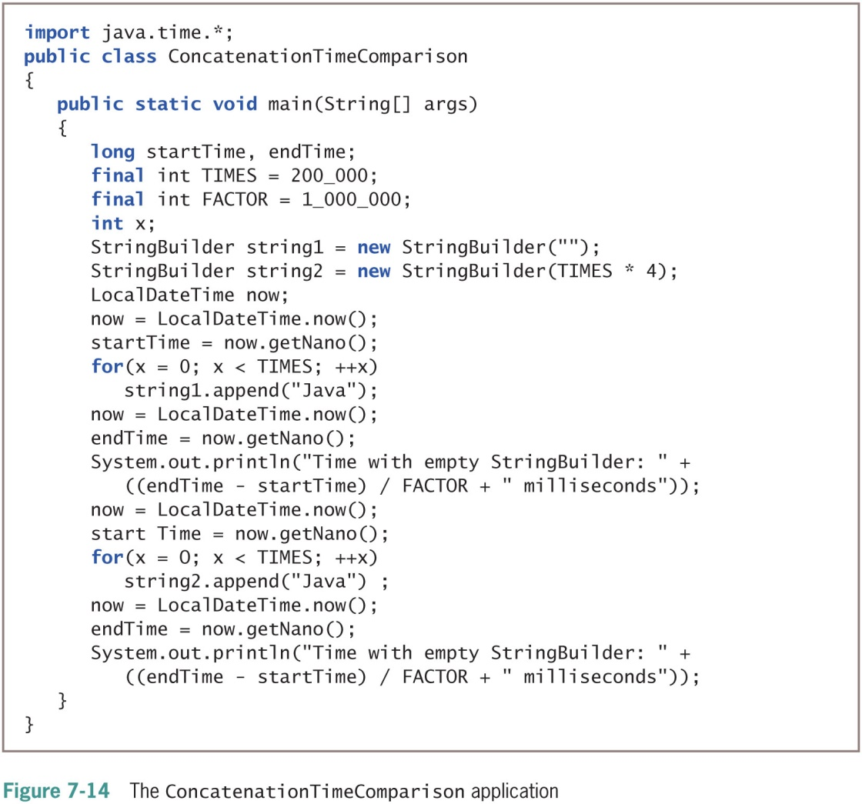
Learning About the StringBuilder and StringBuffer Classes (10 of 10)

Slide 38
Don’t Do It
Don’t attempt to compare Strings using the standard comparison operators
Don’t forget that startsWith(), endsWith(), and replace() are case sensitive
Don’t forget to use the new operator and the constructor when declaring initialized StringBuilder objects
Don’t use StringBuilder or StringBuffer if the String class will work as well

Slide 39
Summary (1 of 2)
String variables
References
Character class
Instances can hold a single character value
Each String class object
Is immutable
equals() method
toString() method
Converts any object to a String

Slide 40
Summary (2 of 2)
Integer.parseInt() method
Takes a String argument and returns an integer value
Double.parseDouble() method
Takes a String argument and returns a double value
StringBuilder or StringBuffer class
Improves performance when a string’s contents must change

